Slide 1



Chemical Passivation of In_{0.53}Ga_{0.47}As(100)
Sanjay Tharmarajah
Yissel Contreras
Anthony Muscat
University of Arizona, Department of Chemical and Environmental Engineering
Arizona Space Grant Symposium
April 22,2017
Tempe, Arizona

Slide 2
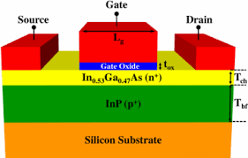
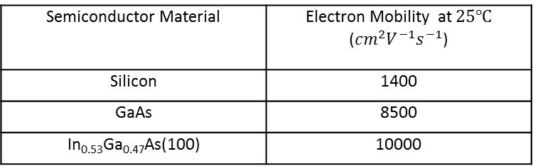
Why III-V Semiconductors
More desirable over Si for high performance transistors due to higher carrier mobilities
In0.53Ga0.47As(100) and InP both have a lattice constant of 5.97 Å
Rapid oxidation in air results in degradation of electrical properties
Semiconductor Material | Electron Mobility at $25℃$ (${cm}^{2}V^{−1}s^{−1}$)
Silicon | 1400
GaAs | 8500
In_{0.53}Ga_{0.47}As(100) | 10000
http://www.ioffe.ru/SVA/NSM/Semicond/
http://iopscience.iop.org/article/10.1088/0268-1242/28/10/105007

Slide 3
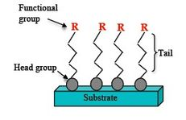

Experimental Approach
Clean semiconductor surface by removing organic material and etching the oxide layer
Deposit a hydrophobic, dense organic layer to prevent oxygen from reacting with the semiconductor surface
oxides
Organic contamination removal using dilute SC1 solution (1:1:10000 v/v NH₄OH:H₂O₂:H₂O)
2X (1 min 0.3 M HF etch)
ET deposition
InGaAs(100)
InGaAs(100)
https://www.revolvy.com/main/index.php?s=Electrochromic%20devices
$$ET$$
1-Eicosanethiol
(ET)
InGaAs(100)

Slide 4


A Hydrophobic Surface is Obtained When ET is Deposited
Hydrophobic
Hydrophillic

Slide 5
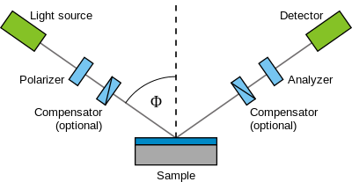

Deposition of an Eicosanethiol Monolayer Confirmed by Ellipsometry
https://en.wikipedia.org/wiki/Ellipsometry
°
°
$$ET$$
InGaAs(100)
InP

Slide 6
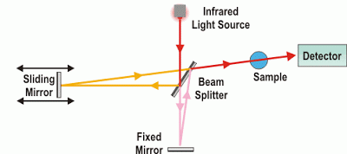
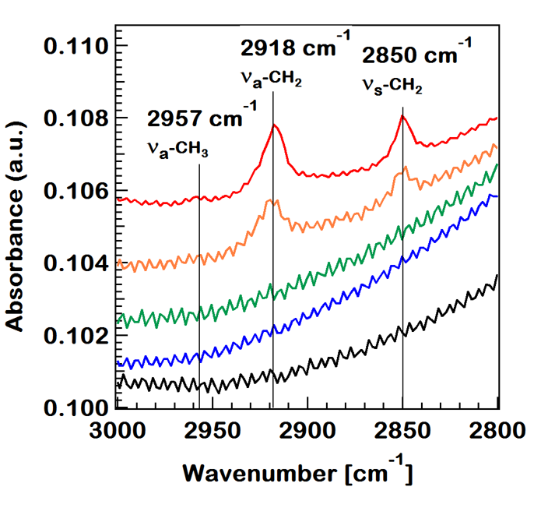
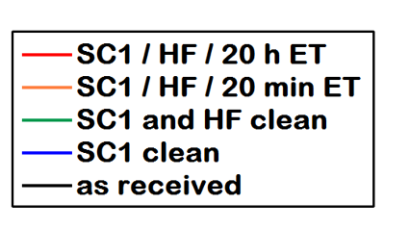
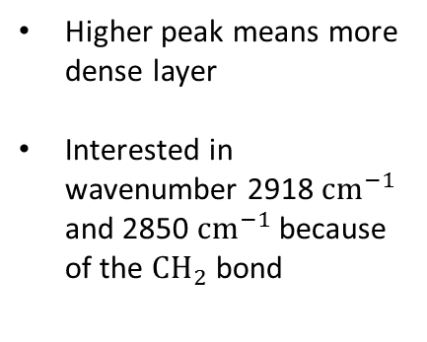
An Ordered ET Layer is Formed with 20 min and 20 h Immersions
http://articheck.co.uk/spectroscopy-series-fourier-transformed-infrared/
All samples exposed to air for 4 min before analysis
Higher peak means more dense layer
Interested in wavenumber 2918 $cm^{−1}$ and 2850 $cm^{−1}$ because of the $CH_{2}$ bond

Slide 7
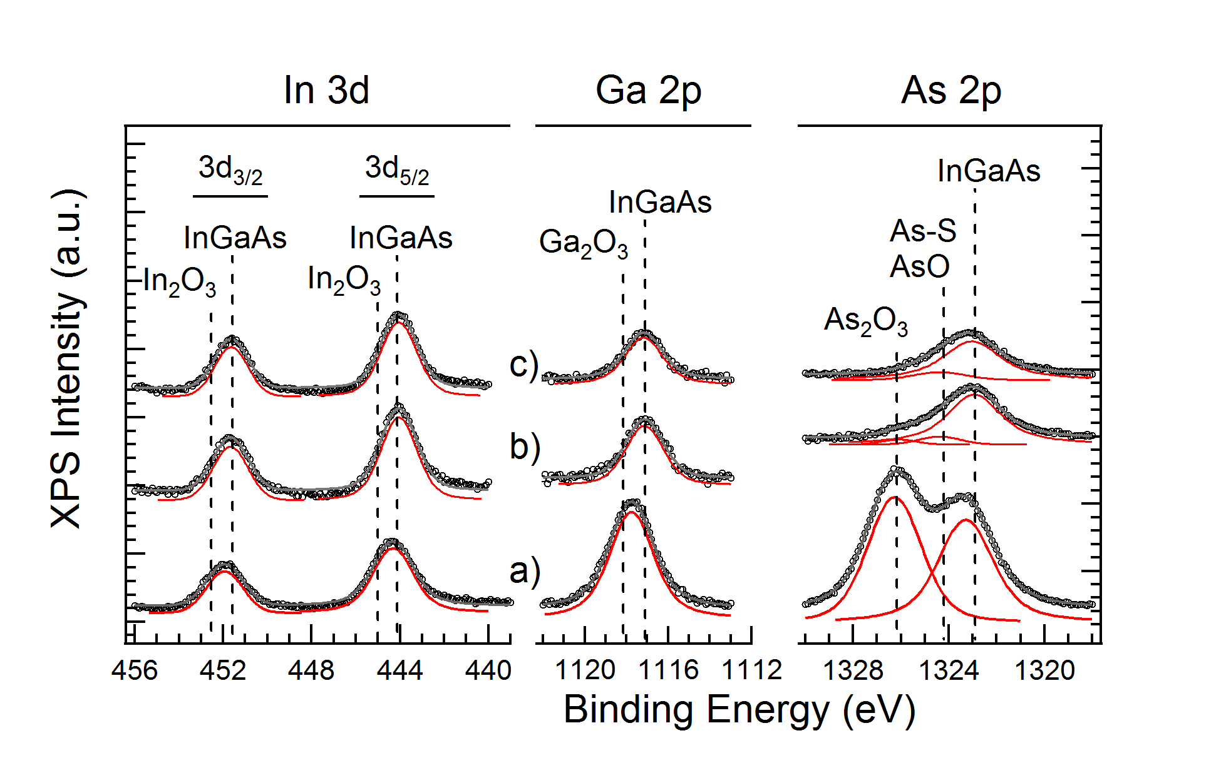
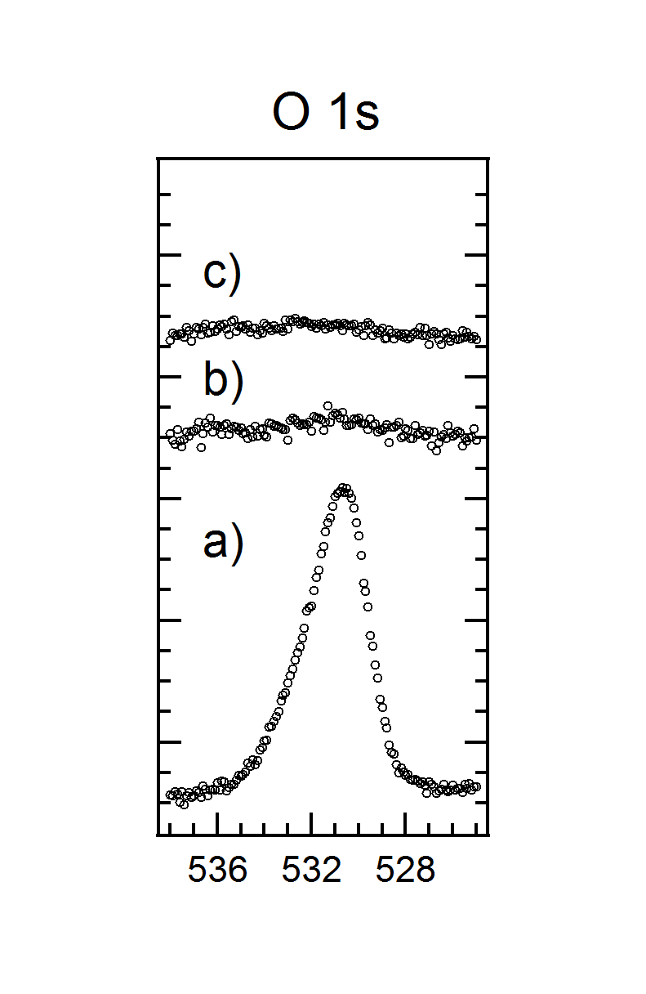
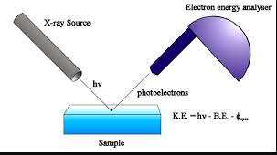
Oxide Re-growth is Minimized by ET Deposition
c) 20 h ET
b) 20 min ET
a) control
https://wiki.utep.edu/display/~anarayanaswamy/X-Ray+Photoelectron+Spectroscopy
All samples were exposed to air for 4 min before analysis
Due the the small escape depth of electrons, x-ray is a surface sensitive technique
A 20 min immersion in ET solution results in a small amount of As oxides are detected
A 20 h immersion in ET solution results in an oxide concentration below XPS detection limits after a 4 min exposure

Slide 8
In Summary
A monolayer of ET was successfully deposited with 20 min and 20 h immersions
The monolayer deposited by the 20 min and 20 h immersion are ordered
20 h immersion in ET solution was more effective in protecting from oxide growth than the 20 min immersion
Future Work:
Analyze various temperatures of ET deposition with XPS and FTIR

Slide 9


Special Thanks to:

Slide 10
Thank You!

